Slide 1
Super Resolution of Land Cover Mapping
(Image Processing)
P.NAVEEN RAJ 2009115061
S.B.YUVARAJA 2009115118
YASWANTH KUMAR 2009115117
PROJECT GUIDE - DR.K.VANI, ASSOCIATE PROFESSOR, DEPT OF IST, ANNA UNIVERSITY

Slide 2
INTRODUCTION

Slide 3
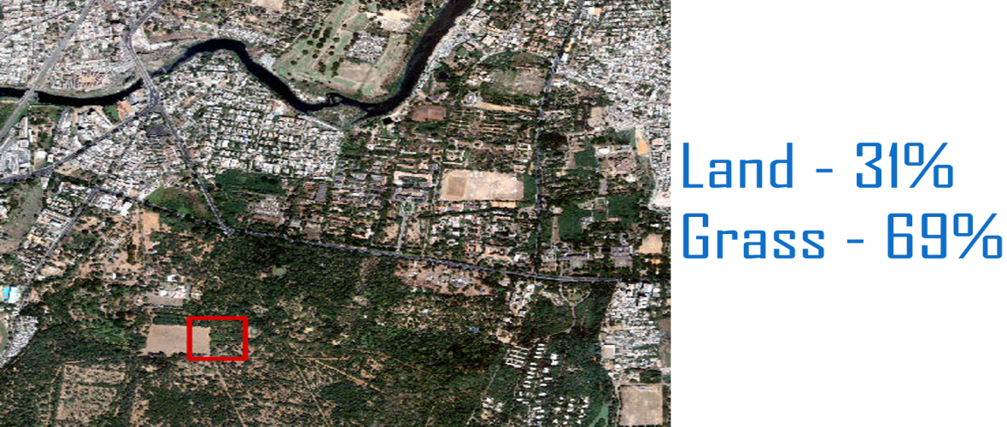
INTRODUCTION
Satellite images are used for preparing latest land cover maps .
Maps prepared through classification( Hard and Soft ).
Hard classification is mapping of the one pixel to one class approximately.
Soft classification is finding of percentage of spectral components in the particular pixel.

Slide 4
INTRODUCTION(COUNT..)
Super Resolution Mapping is the technique that is used to map the identified spectral components in a particular pixel.

Slide 5
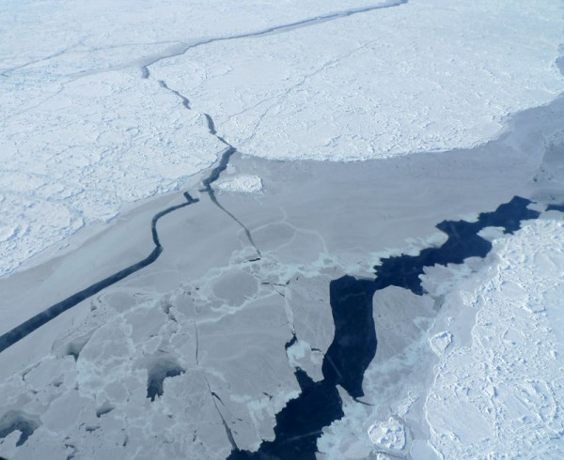
ISSUES IN EXISTING SYSTEMS
Satellite images having lesser resolution will provide land cover mapping with poor accuracy

Slide 6
SOLUTION
Usually one pixel may contain mixed information - Soft Classification preferred.
Soft classification is a technique to predict proportions of land cover classes within mixed pixels using sub pixel classification
Super resolution mapping(SRM) is a technique to predict spatial locations of land cover classes within mixed pixels in remotely sensed imagery using the sub pixel mapping(SPM)
For the SRM we use two step approach
two-step approach first estimates fraction images by spectral un mixing and then inputs fraction images into an SPM algorithm to generate the final sub pixel land cover map

Slide 7



Example
Original image
Hard classification
Super resolution mapping

Slide 8
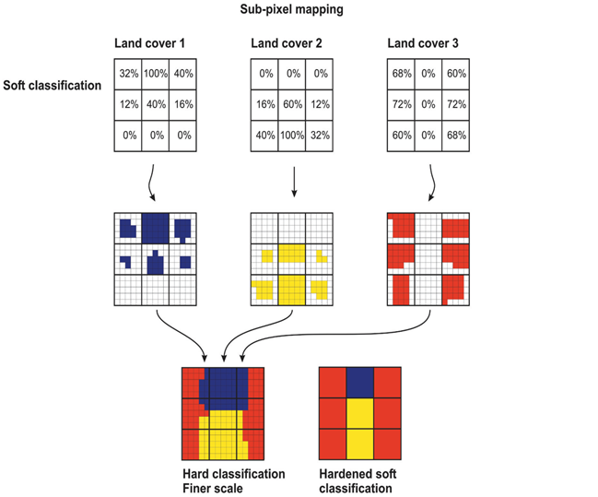

Slide 9
Literature survey
Subpixel Land Cover Mapping by Integrating Spectral and Spatial Information of Remotely Sensed Imagery 2011
Main aim of this work is to retrieve final sub pixel land cover map from the remotely sensed image
linear un mixing model (LUM) is used for spectral un mixing
Maximal spatial dependence model is adopted for SPM

Slide 10
Literature survey – cont..
Spectral and spatial goal functions are combined to form a single optimization function
Min E ( r )= Espectral( r )+λ Espatial( r )
Limitation :
Correlation with nearest pixel is not considered
Attraction between the classes with in the pixel is not consisdered

Slide 11
Literature Survey
Super-resolution land cover pattern prediction using a Hopfield neural network July-2011
Super Resolution Mapping with Hopfield Neural Network using the soft classified proportions is used.
PAN and MS images are processed and compared to find spatial dependence

Slide 12
Literature Survey
Super-resolution land cover pattern prediction using a Hopfield neural network July-2011
Super Resolution Mapping with Hopfield Neural Network using the soft classified proportions is used.
PAN and MS images are processed and compared to find spatial dependence

Slide 13
Literature Survey
Super-resolution land cover pattern prediction using a Hopfield neural network July-2011
Super Resolution Mapping with Hopfield Neural Network using the soft classified proportions is used.
PAN and MS images are processed and compared to find spatial dependence
LIMITATION :
It can provide only local optimization

Slide 14
Literature Survey
Particle swarm optimization-based sub-pixel mapping for remote-sensing Imagery – may 2012
Applying PSO(Particle Swarm Optimization ) algorithm for proportion images.
Integrate the classification map for all classes.
Final SRM map will be obtained

Slide 15
OBJECTIVE
Soft Classification of image :
Spectral components of various classes are identified
Super Resolution Mapping :
Spatial dependence is realized in simple and effective way using attraction and Co-Relation
To obtain more accurate land cover maps from coarser spatial resolution images.
To provide essential metrics for linear feature extraction.

Slide 16
Algorithm
Sub divide the pixel
Allocate the classes randomly according to the area proportion.
Calculate the attraction and correlation between the sub pixels
Applying PSO(Particle Swarm Optimization ) algorithm for all proportion images.
Integrate the classification map for all classes.
Final SRM map will be obtained

Slide 17
System Architecture

Slide 18
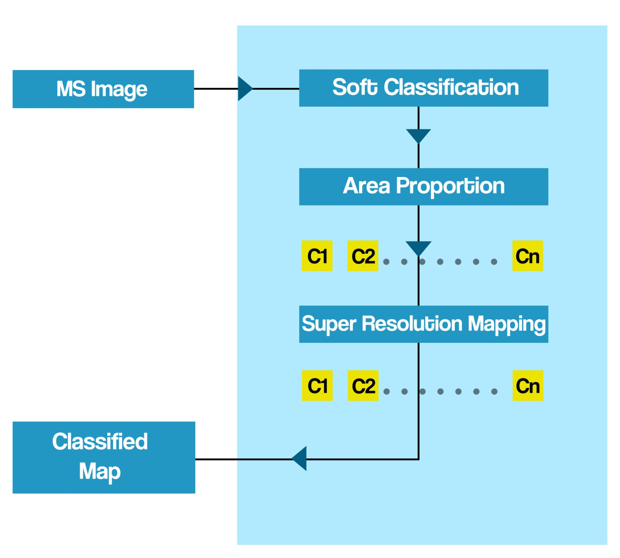
ARCHITECTURE –SRM

Slide 19
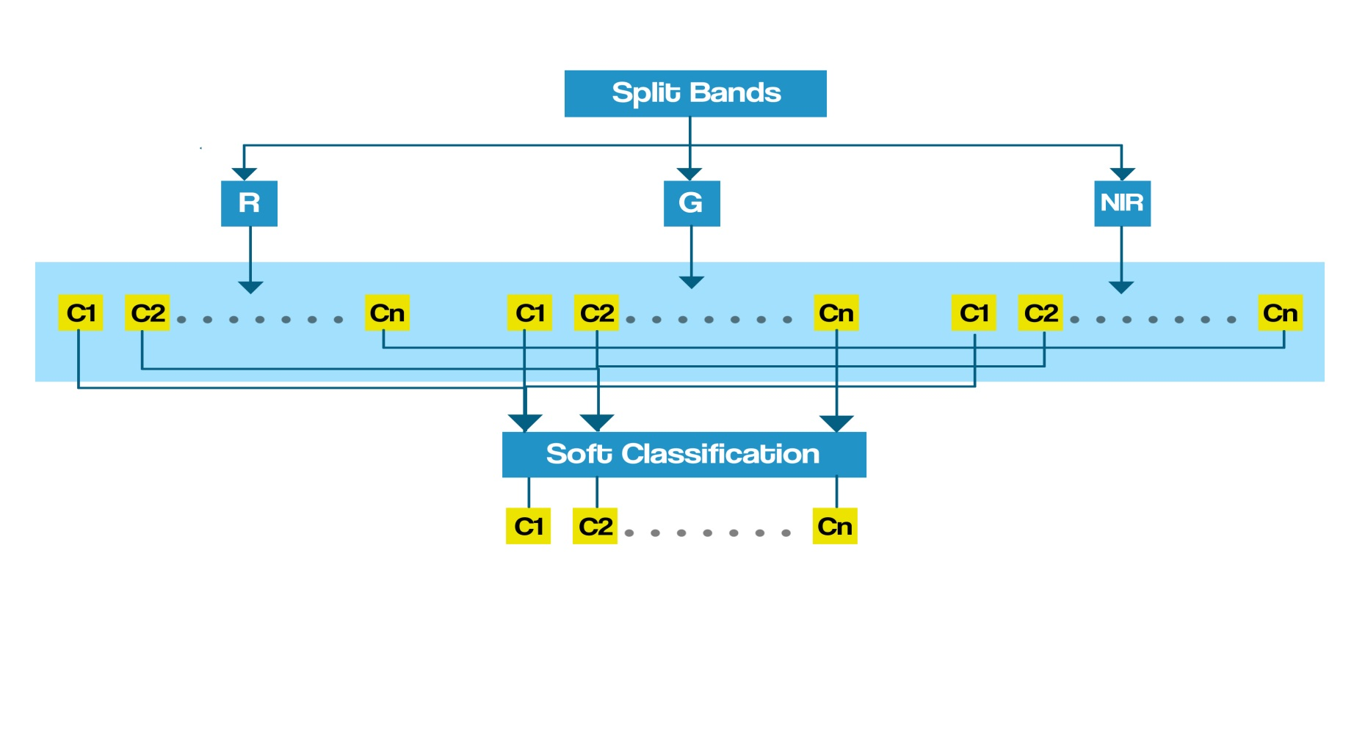
ARCHITECTURE –SOFT CLASSIFICATION

Slide 20
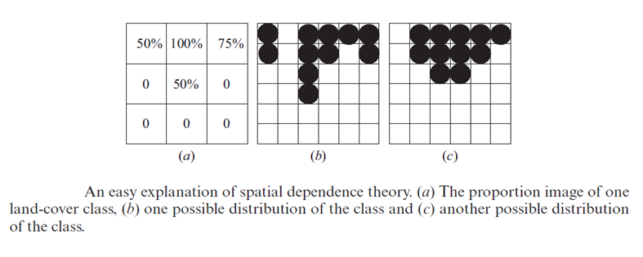
PSO Algorithm(Mapping)

Slide 21
Technologies/Tools Required
Requirement | Technology
Operating System | Microsoft Windows 7
Programming Language | MATLAB
Integrated Development Environment | MATLAB R2009a

Slide 22
Module Description
With Split-Up For Each Member

Slide 23
Module Description and Split- Up
Naveen Raj | Identifying classes Different classes that are to be found are identified
 | 2 . Spectral un mixing in G band Proportion of various classes in G band is found
 | 3 . Identifying correlation between the sub pixels Cor-relation between the nearest sub pixel is found

Slide 24
Module Description and Split- Up
Yuvaraja | Splitting up of bands and pixels Images in R band , G band , NIR band are identified.
 | 2 . Spectral un mixing in NIR band Proportion of various classes in NIR band is found
 | 3 . Identifying attraction between sub pixels Cor-relation between the nearest sub pixel is found

Slide 25
Module Description and Split- Up
Yaswanth | Spectral Un Mixing in R band Proportion of various classes in R band is found
 | 2 . Merging of classes Various band matrix’s are combined and for each class matrix is formed
 | 3 . Applying PSO to obtain final result

Slide 26
Time Chart
With Expected Outcome

Slide 27
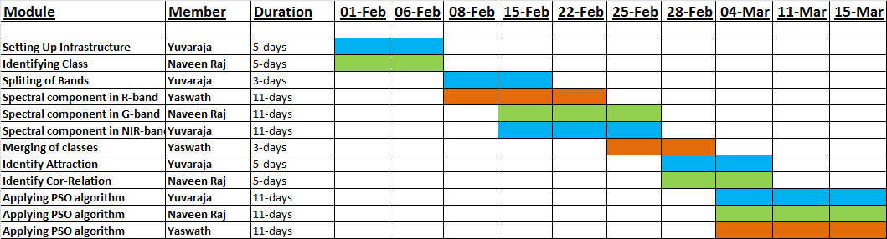
Time Chart

Slide 28
References
A. J. Tatem, H. G. Lewis, P. M. Atkinson, and M. S. Nixon, “Super-resolution land cover pattern prediction using a Hopfield neural network,” Remote Sens. Environ. , vol. 79, no. 1, pp. 1–14, Jan. 2002
Feng Ling, Yun Du, Fei Xiao, and Xiaodong Li“Subpixel Land Cover Mapping by Integrating Spectral and Spatial Information of Remotely Sensed Imagery” IEEE GEOSCIENCE AND REMOTE SENSING LETTERS., 2011 IEEE
P. M. Atkinson, “Issues of uncertainty in super-resolution m apping and their implications for the design of an inter-comparison study,” Int. J.Remote Sens., vol. 30, no. 20, pp. 5293–5308, Oct. 2009
A. J. Tatem, H. G. Lewis, P. M. Atkinson, and M. S. Nixon, “Super-resolution target identification from r emotely sensed images using a Hop-field neural network,” IEEE Trans. Geosci. Remote Sens. , vol. 39, no. 4, pp. 781–796, Apr. 2001

Slide 29
THANK YOU

